Slide 1
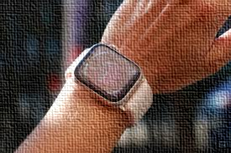
The New Apple watch series 9. Multitask like a C.E.O.
The C.E.O
You’re the C.E.O. Do more seamlessly with this amazing Apple watch series 9.
Equipped with a revolutionary App that helps get things done ASAP. It features a power App that measures your blood oxygen levels. Know your heart wellness for a no worry heart. It has a twice brighter retina display. Now you can see your cool pictures clearly.
Order before Dec 20th and get a copy of Steve Job's inspirational tools.
visit:www.myapplewatch/series9.com
This New Apple watch series 9. Control every aspect of your life. Just like a C.E.O
.
…… Brand: APPLE Prod: Apple watch series 9.

